Slide 1
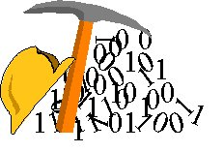
GETTING TO KNOW YOUR DATA

Slide 2
GETTING TO KNOW YOUR DATA TYPES OF DATASETS

Slide 3
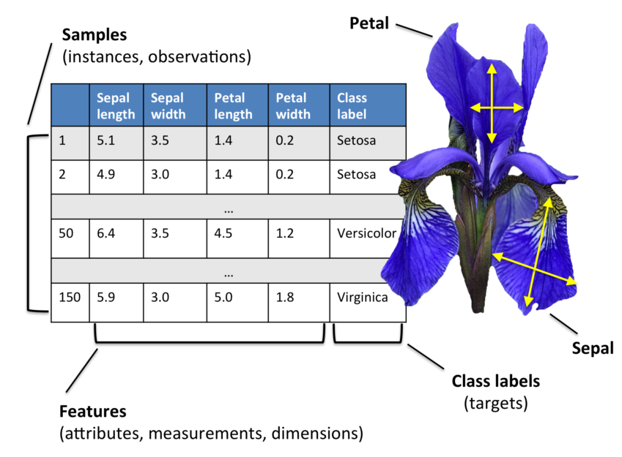
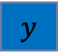
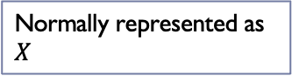
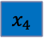
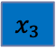
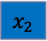
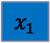
Tabular Representation (Structured Data Rep.)
Usually mapping is stored separately (column index to feature name)
$$x_{1}$$
$$x_{2}$$
$$x_{3}$$
$$x_{4}$$
$$y$$
Normally represented as $X$

Slide 4
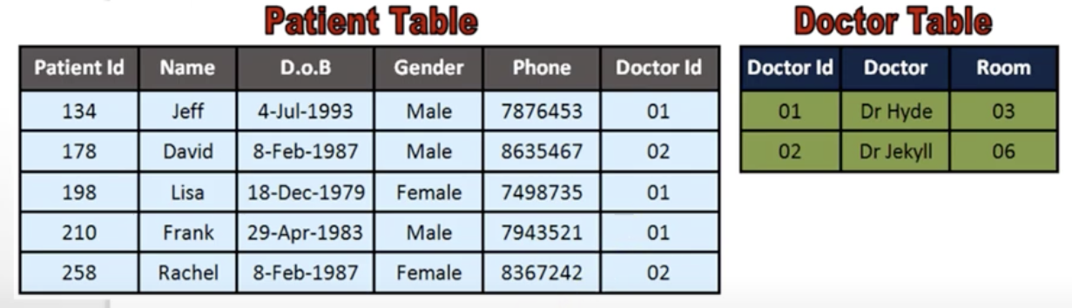
Relational Database
In a typical database system, data is organised in tables:
Traditional database allows to search information in database (e.g. finding all patients that are male and > 20 years old)
Data Mining allows to do more. It allows to find correlations, trends and other complex knowledge in data (e.g. finding that young patients are more likely respond to a given treatment …)

Slide 5
Transactional Data Representation
A database of customer transactions
A transaction is a list of items bought by customers.
May contain additional information
e.g. purchase quantities, unit price, time, location

Slide 6
Textual Representation
Text Documents:
A type of unstructed data, documents that have no clear structure, or are not organized in predefined manner.
Example:
Predicting if someone will like a movie or product
Analyzing an anonymous text to find the likely author. How old he is ? what is the author profile?
Sentiment analysus
Automatic summarization of document

Slide 7
Textual Representation
Usually mapping is stored separately (column index to feature name)

Slide 8
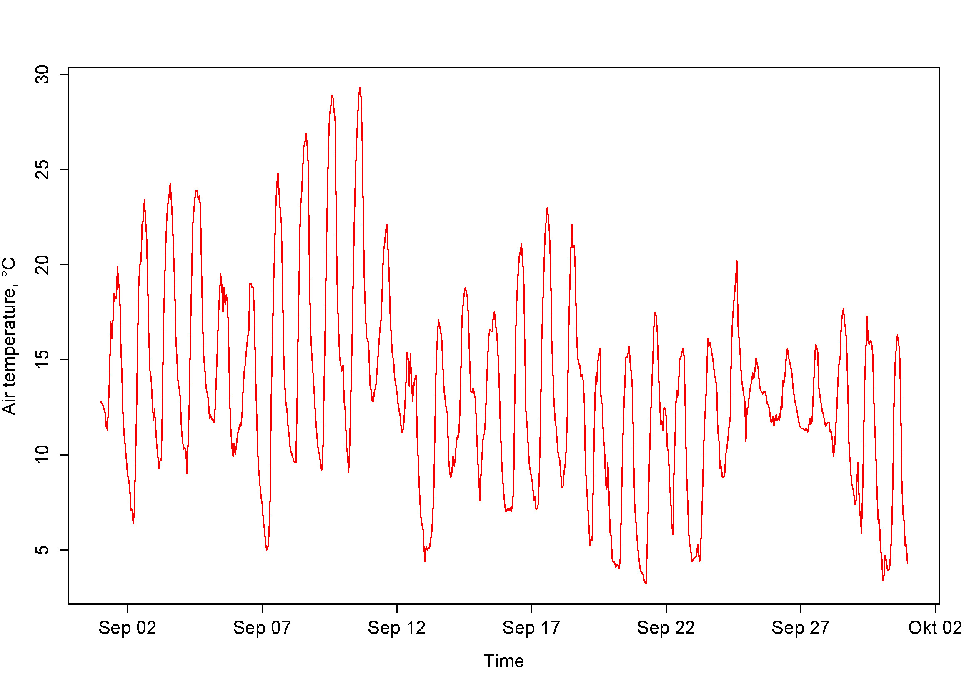
Temporal data
Time series
a series of numeric values
usually obtained at a regular interval
e.g. stock market, EEG data, temperature data, students grade over time.
This Photo by Unknown Author is licensed under CC BY-SA

Slide 9
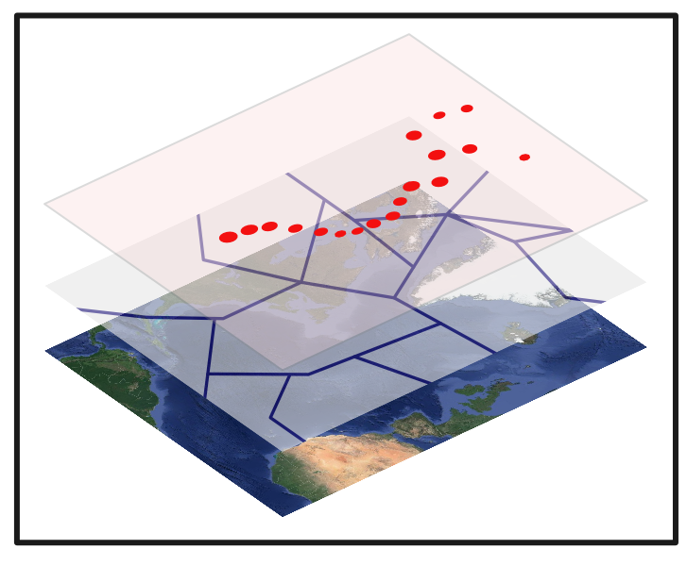
Spatial data
Spatial or geographic data
e.g. forestry, ecology, infrastructure management
Spatio-temporal data
meteorological data, crowd movement, bird migration
This Photo by Unknown Author is licensed under CC BY-SA

Slide 10
Web Data
Web
a set of documents (webpages)
links between documents
Examples
Predicting the next webpage that someone will visit
Automatically grouping webpages by topics into categories
Analyzing the time spent on webpages
Analyzing data from attacks by hackers on a website.

Slide 11
Graphs
Social network
Finding communities
Analyzing the relationships between people
Predict who will be your friend
Observe how communities evolve
Find who has the most influence
Find the location of a person
Infer the psychological profile of a person
Study trends
Chemical Molecules

Slide 12
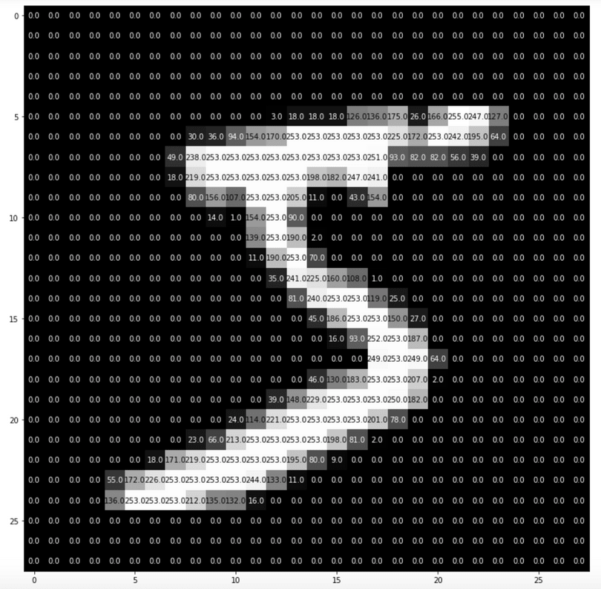
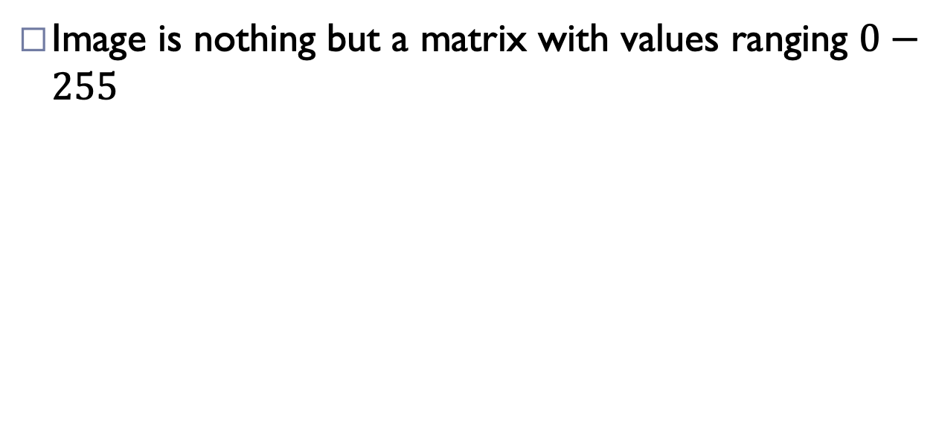
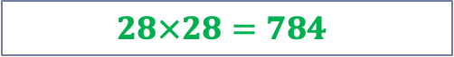
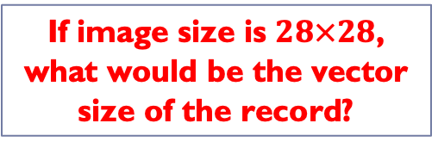
Images Data Representation
Image is nothing but a matrix with values ranging $0−255$
0 | 0 | … | 255 | 253 | 252 | … | 0 | 0 | 0
If image size is $28×28$, what would be the vector size of the record?
$$28×28=784$$

Slide 13
Hetrogenous Data
Sometimes, we need to analyze data combining mutilple types of data (e.g. spatial, temporal, time series, text, GPS, etc.)
We may also need to analyze data stored using different technologies and file format (e.g. Excel files, text files, word documents, pictures, videos, GPS data, audio)

Slide 14
Types of Data Sets
Record
Relational records
Data matrix, e.g., numerical matrix, crosstabs
Document data: text documents: term-frequency vector
Transaction data
Graph and network
World Wide Web
Social or information networks
Molecular Structures
Ordered
Video data: sequence of images
Temporal data: time-series
Sequential Data: transaction sequences
Genetic sequence data
Spatial, image and multimedia:
Spatial data: maps
Image data:
Video data:

Slide 15








Putting it all together: Data Mining Process
Bellis Perenis
Rosa Multiflora
Rosa Multiflora
Bellis Perenis
Tulipa
Bellis Perenis
Tulipa
Tulipa
Rosa Multiflora
Bellis Perenis
Notes:
This is an animated slide – use the notes below to talk to each animation build (clicks are indicated by numbers)
Machine Learning is a technique we can use to create predictive models based on relationships in data.
So what does that mean? Well, let's look at an example:
Suppose a botanist collects some samples of flowers. {The slide shows images of various flowers}
Each sample has some features, such as measurements of the petals, stem, and other details); and the botanist can provide a label for the flower using its species name. {The Latin name for each flower species appears}
The sample data is then processed using an algorithm that tries to find a relationship between the features and the label. {The flowers are fed into a pair of turning cogs}
The result of this algorithm is a machine learning model. {A human head with cogs for a brain appears}
And since the model has learned the relationship between the features and label, you can use it to predict the species of a flower based on its features. {A new flower appears, and the human head identifies its species}

Slide 16
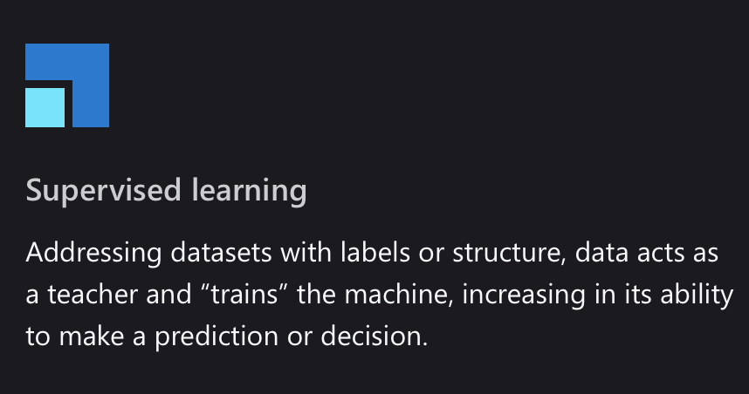
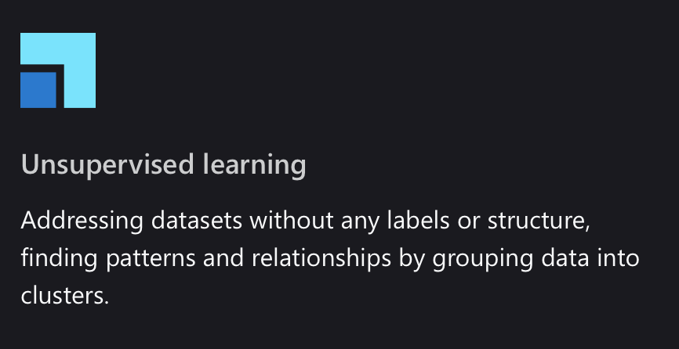

Techniques

Slide 17




Regression
56 | 115
61 | 126
67 | 137
72 | 140
76 | 152
82 | 156
x y
Training
ŷ
116
128
137
146
155
1.5
f(x)
1
35
f(x)=35 + 1.5x
54 | 114
62 | 129
68 | 130
74 | 152
80 | 154
Validation
Notes:
This is an animated slide – use the notes below to talk to each animation build (clicks are indicated by numbers)
One of the most common machine learning technique is called regression. You use regression when you want to predict a numeric value; like a price, a sales total, or some other measure.
Let's look at an example and get an idea of how it works. There's a little mathematics involved, but don't worry – the basic idea is fairly straightforward!
In this example, we'll imagine a bicycle rental company that wants to predict the number of rentals on a given day based on weather conditions.
We'll start with some historical data about cycle rentals. For this simple example, we'll restrict this to just the temperature and number of rentals per day. In reality there would be more factors to consider. {A table of data showing daily temperatures and the number of rentals appears}
The number of rentals is the label we're going to predict, and we're going to use the daily temperature as a feature on which to base the prediction. Generally, we refer to the feature (or features) as X and the label as Y; and what we're going to do is to try to figure out a function that we can apply to X to get the value of Y. This function will be the basis for a model that we can use to predict Y for any given value of X. {X appears above the temperature column, and Y appears above the rentals column}
When we find a function, we'll want to validate it with some data for days where we already know the number of rentals so we can see how well it predicts; so we'll split the data into a subset that we'll use the train the model, and hold back a subset for validation. {The table is split into a training subset and a validation subset}
To find an appropriate function, let's plot the X and Y values so we can visualize the relationship between them. {A chart showing X values plotted against Y values from the training subset is displayed
Looking at the plot, you can see a trend in which higher temperatures tend to correlate with more rentals. In fact, we can fit a line between the plotted points that more or less describes this correlation and we can use this line to work out a calculation that produces Y from X. The ability to use a line like this to define a function for the X/Y relationship is technically called linear regression; which sounds complicated, but let's look at the basic principle of how it works and hopefully you'll find that it's actually fairly intuitive. {A diagonal line showing a trend where high X values tend to correlate to high Y values is added to the chart}
The point where the line intercepts the Y axis is around 35… {The point where the line intersects the Y axis is highlighted on the chart}
…and the slope of the line is such that for every 1 unit of X it goes along, it goes up around 1.5 units of Y… {The slope of the line is shown by an arrow going left for 1 unit and an arrow going up for 1.5 units}
…so the function that operates on X to find Y is 35 plus 1.5 times X. {The function "f(x) = 35 + 1.4x" is displayed}
Now we can test that function with the validation data that we held back. Here are the values we get from the function for the temperatures on those days – because this is a prediction of Y rather than the actual Y value, we write it with a little "hat" and call it Y-hat. {A column of values calculated by using the function is added alongside the actual Y values in the validation subset}
Let's plot the actual values from the validation data along with the line from which the predicted values were calculated. {The actual values from the validation subset are plotted on the chart alongside the line that represents the predictive function}
Now we can see how well the model predicts by measuring the difference between the predicted values and the actual values that we know to be true – this tells us the amount of error in the model. There are various ways to calculate this error value and generate common metrics that we can use to evaluate a regression model. {Arrows indicating the distance between each actual value and the prediction function line are added to the chart}
This is a simple example, just to describe the general concepts and process for training and evaluating a regression model. In a real-world scenario, the training algorithm would need to fit multiple features (X values) to a regression function; but the basic principles remain the same. You start with some data that contains features and labels, you use some of the data to train a regression model by using an algorithm that tries to determine a function for X that predicts Y; and then you evaluate the trained model using the validation data that you held back. If you're happy with the level of error in the model, you can then use it to infer unknown label values in new cases.

Slide 18








Classification
[4,2,3.2,10] | 0
[6,3,1.7,12] | 1
[5,2,3.5,11] | 0
[4,1,2.9,10] | 0
[7,4,2.1,11] | 1
Actual
x y
1
0
1
1
126
21
1
[7,4,2.1,11]
Predicted
[7,3,1.8,11]
True Positive
7
1
1
119
[6,3,1.7,12]
0
Training
[4,8,2.5,10]
False Positive
[4,1,3,1,11]
[5,2,3.5,11]
False Negative
P(1) | P(0) | ŷ
0.2 | 0.8 | 0
0.9 | 0.1 | 1
0.6 | 0.4 | 1
0.3 | 0.7 | 0
[4,2,3.2,10]
[3,1,2.8,10]
True Negative
[3,1,2.8,10] | 0
[7,3,1.8,11] | 1
[4,8,2.5,10] | 0
[4,1,3,1,11] | 1
[4,1,2.9,10]
Validation
Notes:
This is an animated slide – use the notes below to talk to each animation build (clicks are indicated by numbers)
Regression is a form of supervised machine learning – in other words it relies on us having some data with known label values that we can fit to a model, which can then be applied to new data for which we don’t have the label values. Now let's look at another type of supervised machine learning – classification.
Again, there's some mathematics involved – in particular, probability. Don’t worry too much about the details – just remember that probability is always a value between 0 and 1, where 1 means a definite, 100% certainty.
Just as with regression, we start with some data that includes features and known labels. In this case, the features are medical measurements that might be taken during a health checkup – such as weight, height, blood pressure, and so on. This time, the label isn't a numeric value but an indicator of whether the patient is diabetic (in which case the label has a value of 1) or not (in which case it is 0). The label indicates to which class the patient belongs – diabetic or non-diabetic. {A table of data appears. In the first column, the values are vectors (lists) of diagnostic measurements. The second column contains a 1 or a 0}
Once again, we split the data into subsets for training and validation. {The table is split into training and validation subsets}
Now, we'll take the training values and apply an algorithm that fits them to a function so that the Y value is between 0 and 1, like this. {A chart showing the feature vectors plotted against the label values is displayed
Since the value can be anywhere between 0 and 1, a threshold value is used to determine the cut-off point where the class is considered to be 0 or 1. In this case, all patients with features producing a value greater than 0.5 are diabetic, and those with values below that threshold are not. {A line is added to the chart at the 0.5 threshold – all points plotted above this represent diabetic patients, and all points below represent non-diabetic patients}
The function we've fitted to the data is an example of a logistic function. You can think of the value as representing the probability that the class is 1 (in other words, that the patient is diabetic). {A Sigmoidal (s-shaped) function graph is shown with a minimum value of 0 and a maximum of 1}
Having determined a function that fits our features, a model is produced and we can use the validation data we held back to test it. Here are the results of applying the logistic model to our validation features. {The validation data points are plotted on the chart alongside the predictive function}
The function returns the probability that the class is 1, or positive, as a value between 0 and 1; and since there are only two possible classes, and there's a 100% probability that the patient is one of them (they're either diabetic or not!), the probability that the class is 0, or negative, is also known (it's just 1 minus the probability that it's positive) The class with the highest probability is the predicted value for Y. {A table showing the probability values for each possible class calculated by the function, and consequent 1 or 0 class prediction, is shown alongside the validation subset}
Let's look at the first validation case. In this case, the predicted class label is 0 and the actual label is also 0, so the model got it right. It's a true negative. {A tick appears alongside the first prediction}
The second case results in a prediction of 1 for an actual value of 1, so again it's correct – this time it's a true positive. {A tick appears alongside the second prediction}
For the third case, the prediction is 1 but the actual label is 0, so the model got this one wrong – it’s a false positive. {A cross appears alongside the third prediction}
The fourth one is also wrong – this time, a false negative. {A cross appears alongside the fourth prediction}
To evaluate the model, we tabulate the prediction results in a format called a confusion matrix, like this. {A 2 by 2 matrix of actual labels of 1 and 0 crossed with predicted labels of 1 and 0 is displayed, and the plotted points move to the appropriate quadrant of the matrix based on their predicted and actual values}
In a real scenario, you'd use much more validation data than we have on the slide, so it might end up looking something like this. {The numbers in the matrix increase to show 126 true positives, 7 false positives, 119 true negatives, and 21 false negatives}
If we apply a heatmap to this, intensifying the cells in the matrix to reflect the values, you can easily see that the correct predictions in the true positive and true negative cells form a dark diagonal line from top left to bottom right – indicating that the model got more predictions right than wrong. {The quadrants in the matrix are shaded, with higher values darker than lower values – this reveals a diagonal pattern of high values for true positives and true negatives}
From the values in the confusion matrix, you can calculate multiple metrics that can be used to measure the performance of the model.

Slide 19








Clustering
 | 6 | 3
 | 5 | 3
 | 2 | 3
 | 1 | 3
 | 3 | 8
 | 4 | 8
Notes:
This is an animated slide – use the notes below to talk to each animation build (clicks are indicated by numbers)
Regression and Classification are both forms of supervised machine learning.
Now let's look at a form of unsupervised machine learning – clustering.
Suppose we collect some observations of flowers, noting the height and number of petals for each sample. What we want to do is group flowers that are similar together, but we have no known label that we can use to train a model. {A table of flower heights and petal counts is shown}
Instead, we think of the feature values that we have as being coordinates on which we can plot the sample data points – in this case we have two features, height and petals, so we can plot them on a 2-dimensional grid like this. {A grid is shown with flowers plotted for each height and petal count coordinate pair}
Now we need to decide how many clusters we want to group the observations into. This value is generally referred to as K, and we simply assign K points at random locations on our grid like this. In this case, we've used a K value of 3; so we'll end up with 3 clusters. {Three centroid points are plotted on the grid at random coordinates}
Each of the K points we've plotted will be a centroid for a cluster, so we assign the sample data points to its nearest centroid. {Three shaded cluster areas enclosing the flowers that are nearest to each randomly plotted centroid is added}
Now we move each centroids to the middle of the points in its cluster – based on the mean distance. {The centroid points are moved to the center of the flowers in their cluster}
Now that the centroids have moved, some sample points might be nearer to a different centroid from the one they're currently allocated to; so we reallocate the samples to their nearest centroid. {The cluster shapes are redrawn to reflect the flowers that are now closest to each centroid}
And then we just repeat the process until the clusters are stable, or we reach a pre-determined maximum number of iterations. In this case, the clusters soon stabilize as well-separated groups of related flowers. {The centroids are iteratively moved to the middle of their cluster and the clusters reallocated until a stable set of separated clusters is defined and the centroids are fixed in the middle of their flowers}
This clustering technique, which uses K centroids and moves them to the mean distance between their data points is known as K-Means clustering.

Slide 20
GETTING TO KNOW YOUR DATA ATTRIBUTE TYPES

Slide 21
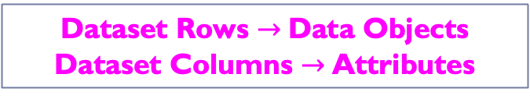
Data Objects
Data sets are made up of data objects
A data object represents an entity
Examples:
Sales Database: Customers, store items, sales
Medical Database: Patients, treatments
University Database: Students, professors, courses
Data objects are described by attributes
Also called: samples, examples, instances, data points, objects, records
Also called: dimensions, features, variables
Dataset Rows $→$Data Objects
Dataset Columns $→$Attributes

Slide 22
EXAMPLE
 | Name | Age | Location | gender | Marital status
s1 | xyz | 25 | DHA | M | U
s2 | abc | 34 | JT | F | M
s3 | qwe | 29 | JT | M | M
…. | … | …. | …. | …. | ….

Slide 23
Attributes
Attribute (or dimensions, features, variables): a data field, representing a characteristic or feature of a data object.
E.g., customer _ID, name, address
Types of Attributes:
Nominal
Binary
Ordinal
Numeric: quantitative
Interval-scaled
Ratio-scaled

Slide 24
Qualitative Attribute Types
Nominal: categories, states, or “names of things”
No meaningful order (enumerations)
Hair_color = {auburn, black, blond, brown, grey, red, white}
marital status, occupation, ID numbers, zip codes
Possible to represent with numbers (haircolor: black = 0 brown = 1 and so on)
May have integer value but not considered numeric ID vs age
No sense to find mean and median. Mode can be useful
Binary
Nominal attribute with only 2 states (0 and 1)
Symmetric binary: both outcomes equally important
e.g., gender
Asymmetric binary: outcomes not equally important.
e.g., medical test (positive vs. negative)
Convention: assign 1 to most important outcome (e.g., HIV)

Slide 25
Qualitative Attribute Types
Ordinal
Values have a meaningful order (ranking) but magnitude between successive values is not known.
Size = {small, medium, large}, grades, army rankings, professional ranks
Ordinal attributes are used in surveys for ratings.
Can be obtained from the discretization of numeric quantities
Mode and Median can be used
Nominal, binary and ordinal are qualitative attributes.

Slide 26
Numeric Attribute Types
Quantity (integer or real-valued)
Interval
Measured on a scale of equal-sized units
Values have order
E.g., temperature in C˚or F˚, calendar dates
No true zero-point (0˚C doesn’t indicate no temperature)
Cannot speak of values in terms of ratios
Mean, median and mode all valid

Slide 27
Numeric Attribute Types
Quantity (integer or real-valued)
Ratio
Inherent zero-point
Values can be represented in ratios of each other
We can speak of values as being an order of magnitude larger than the unit of measurement (10 K˚ is twice as high as 5 K˚).
e.g., temperature in Kelvin, length, counts, monetary quantities, no. of words, years of experience
0 K˚ means particles with zero kinetic energy

Slide 28
Discrete vs. Continuous Attributes
Discrete Attribute
Has only a finite or countably infinite set of values
E.g., zip codes, profession, or the set of words in a collection of documents
Sometimes, represented as integer variables
Note: Binary attributes are a special case of discrete attributes
Continuous Attribute
Has real numbers as attribute values
E.g., temperature, height, or weight
Practically, real values can only be measured and represented using a finite number of digits
Continuous attributes are typically represented as floating-point variables

Slide 29
One-Hot Encoding
Sometimes it is a good idea to encode categorical attributes to one-hot vectors
Gender
Male
Female
Female
Male
..
..
..
Gender
0
1
1
0
..
..
..
Male | Female
1 | 0
0 | 1
0 | 1
1 | 0
.. | ..
.. | ..
.. | ..

Slide 30
GETTING TO KNOW YOUR DATA BASIC STATISTICAL DESCRITION OF DATA Central Tendency, Variation and Spread

Slide 31
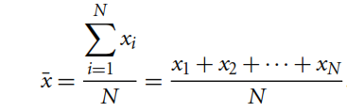
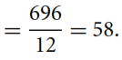
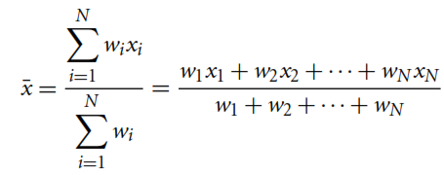
Measuring the Central Tendency
Mean (Arithmetic Mean)
Sometimes each value $x_{i}$ may be associate with a weight $w_{i}$
Mean is sensitive to extreme values!
Sometimes called $μ$
Weighted Arithmetic Mean (or Weighted Average)

Slide 32
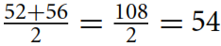
Measuring the Central Tendency
Median
The middlemost value of the data (if number of data points are odd)
Average of two middlemost values of the data (if number of data points are even)

Slide 33
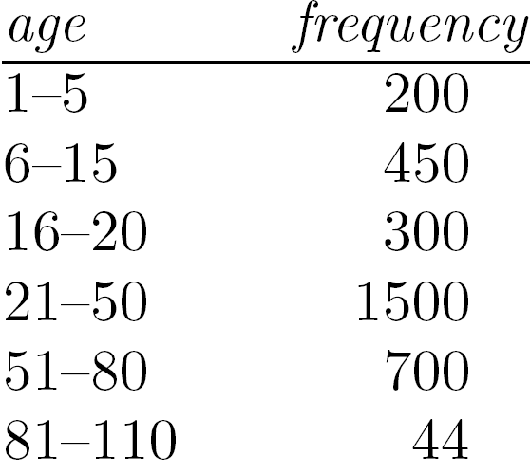
Measuring the Central Tendency
Median:
Good for skewed (asymmetric) data
Middle value if odd number of values, or average of the middle two values otherwise
Concept can be extended to ordinal data (odd – middle value even – median not unique)
Expensive when data is huge
Estimated by interpolation (for grouped data):
No. of values
Sum of frequencies of all the intervals that are lower than medial interval
Width of median range
Lower boundary of median range
Frequency of median interval

Slide 34
Median Estimation
age | Freq | Cum Freq
1-5 | 200 | 200
6-15 | 450 | 650
16-20 | 300 | 950
21-50 | 1500 | 2450
51-80 | 700 | 3150
81-110 | 44 | 3194

Slide 35
Measuring the Central Tendency
Mode
The most frequently occurring value of the data
Datasets with one, two, or three modes are called unimodal, bimodal, or trimodal respectively

Slide 36
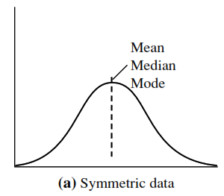
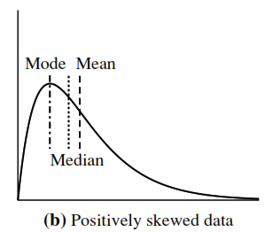
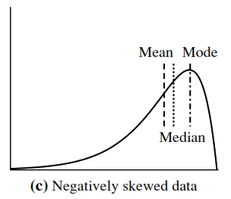
Symmetric VS Skewed Data

Slide 37
Five Number Summary of Dataset
Minimum Value
Lower Quartile (Q1)
Median (Q2)
Upper Quartile (Q3)
Maximum Value
How to compute 5-number summary?

Slide 38
Five Number Summary of Dataset
Sort the data, if not done already.
How to find median if the total number of data points is not odd?
Min
Q1
Median
Q3
Max
56
76
100

Slide 39
Five Number Summary of Dataset
Sort the data, if not done already.
Min
Q1
Median
Q3
Max
56
70
76
86
100

Slide 40
Five Number Summary of Dataset
Sort the data, if not done already.
Called Middle 50% (or IQR)
Any better way to represent this summary?
Lower Extreme
Min
Q1
Median
Q3
Max
56
Lower Quartile
70
Middle Quartile
76
Upper Quartile
86
Upper Extreme
100

Slide 41
Variance and Standard Deviation
Data Set 1: 3, 5, 7, 10, 10
Data Set 2: 7, 7, 7, 7, 7
Data Set 1: mean = 7, median = 7
Data Set 2: mean = 7, median = 7
But we know that the two data sets are not identical! The variance and standard deviation shows how they are different.

Slide 42
Variance and Standard Deviation
Both Indicate how spread out a data distribution is.
Square root of variance is called Standard Deviation
A low standard deviation means that data observations tend to be very close
A high standard deviation indicates that data observations are spread over a large range of values
Recall example of Mean we computed earlier…

Slide 43
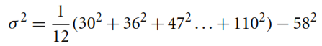
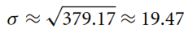
Variance and Standard Deviation
Variance
Standard Deviation
$${Variance(σ}^{2})=\frac{1}{N}\sum_{i=1}^{N}{{\left(x_{i}− \overline{x}\right)}^{2}}$$
$${Variance(σ}^{2})=\left( \frac{1}{N}\sum_{i=1}^{N}{x_{i}^{2}}\right)−{\overline{x}}^{2}$$
How many standard deviations away are these data points from mean?

Slide 44
Variance and Standard Deviation
One Standard Deviation
Two Standard Deviations
Three Standard Deviations
$$(μ±σ)$$
$$STD_{away}= \frac{x_{i}−\overline{x}\left(or μ\right)}{σ}$$
Z-Score
$$STD_{away}= \frac{70−58}{19.47}=0.62$$
$$(μ±2σ)$$
$$STD_{away}= \frac{30−58}{19.47}=−1.44$$
$$(μ±3σ)$$
How many standard deviations away are these data points from mean?

Slide 45
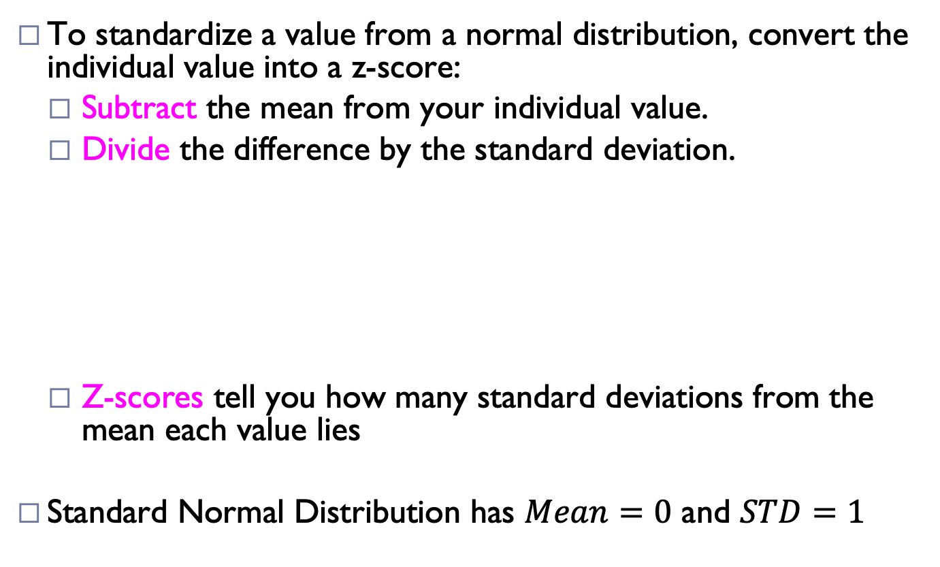
Z-Score: Standard Normal Distribution
To standardize a value from a normal distribution, convert the individual value into a z-score:
Subtract the mean from your individual value.
Divide the difference by the standard deviation.
Z-scores tell you how many standard deviations from the mean each value lies
Standard Normal Distribution has $Mean=0$ and $STD=1$
$$Z= \frac{x−μ}{σ}$$
$$Also called Z−score normalization$$
Working Example and Explanation: https://www.scribbr.com/statistics/standard-normal-distribution

Slide 46
Z-Score: Standard Normal Distribution
A positive z-score means that your x-value is greater than the mean.
A negative z-score means that your x-value is less than the mean.
A z-score of zero means that your x-value is equal to the mean.
Note: Relative Grading is done using Z-Score
Working Example and Explanation: https://www.scribbr.com/statistics/standard-normal-distribution

Slide 47
Properties of Normal Distribution Curve
AKA Empirical Rule
In a Normal Distribution Curve:
From $μ−σ$ to $μ+σ$: Contains about 68% of the data
From $μ−2σ$ to $μ+2σ$: Contains about 95% of the data
From $μ−3σ$ to $μ+3σ$: Contains about 99.7% of the data

Slide 48
GETTING TO KNOW YOUR DATA BoxPlot, Histogram,Line Chart, Parallel Coordinate Plot and Scatter Plot,Quantile Plot, Q-Q Plot

Slide 49
Graphic Displays of Basic Statistical Descriptions
Boxplot: graphic display of five-number summary
Histogram: x-axis are values, y-axis repres. frequencies
Quantile plot: each value x_{i} is paired with f_{i} indicating that approximately 100 f_{i} % of data are ≤ x_{i}
Quantile-quantile (q-q) plot: graphs the quantiles of one univariant distribution against the corresponding quantiles of another
Scatter plot: each pair of values is a pair of coordinates and plotted as points in the plane

Slide 50
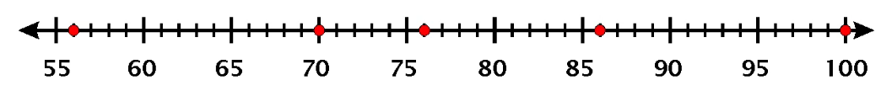
Box and Whisker Plot (aka Boxplot)
Boxplot is helpful in a lot of ways!
An extreme value that is at abnormal distance from other values.
Can be used to find Outliers!
IQR
What distance is abnormal?
What is an outlier?
MIN
Q1
Median
Q3
MAX

Slide 51
Outlier Detection with IQR
$$IQR=Q3 −Q1$$
$$OutlierThreshold=1.5×IQR$$
$$IQR=86 −70=16$$
IQR
$$OutlierThreshold=1.5×16=24$$
$$Outlier= Q1 − OutlierThreshold$$
$$Outlier= Q3 + OutlierThreshold$$
MIN
Q1
Median
Q3
MAX
Useful Article: https://www.thoughtco.com/what-is-the-interquartile-range-rule-3126244

Slide 52
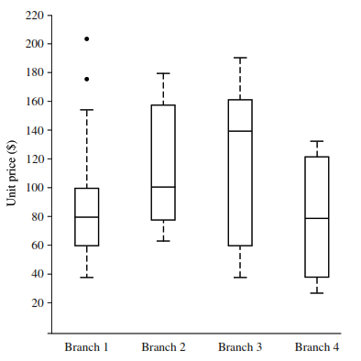
Boxplots with Outliers
Extend whiskers to extreme low and high observations only if these values are less than $1.5×IQR$

Slide 53
Drawing a Box Plot.
Example 1: Draw a Box plot for the data below
Q₁
Q₂
Q₃
4, 4, 5, 6, 8, 8, 8, 9, 9, 9, 10, 12
Lower Quartile = 5½
Upper Quartile = 9
Median = 8

Slide 54
Drawing a Box Plot.
Example 1: Draw a Box plot for the data below
Q₁
Q₂
Q₃
4, 4, 5, 6, 8, 8, 8, 9, 9, 9, 10, 12
Lower Quartile = 5½
Upper Quartile = 9
Median = 8
4
5
6
7
8
9
10
11
12

Slide 55
Drawing a Box Plot.
Example 2: Draw a Box plot for the data below
Q₁
Q₂
Q₃
3, 4, 4, 6, 8, 8, 8, 9, 10, 10, 15,
Lower Quartile = 4
Upper Quartile = 10
Median = 8
3
4
5
6
7
8
9
10
11
12
13
14
15

Slide 56
Drawing a Box Plot.
Question: Stuart recorded the heights in cm of boys in his class as shown below. Draw a box plot for this data.
Q_{L}
Q₂
Q_{u}
137, 148, 155, 158, 165, 166, 166, 171, 171, 173, 175, 180, 184, 186, 186
Lower Quartile = 158
Upper Quartile = 180
Median = 171
130
140
150
160
170
180
cm
190

Slide 57
Drawing a Box Plot.
Question: Gemma recorded the heights in cm of girls in the same class and constructed a box plot from the data. The box plots for both boys and girls are shown below. Use the box plots to choose some correct statements comparing heights of boys and girls in the class. Justify your answers.
Boys
130
140
150
160
170
180
cm
190
Girls
1. The girls are taller on average.
2. The boys are taller on average.
3. The girls show less variability in height.
5. The smallest person is a girl.
4. The boys show less variability in height.
6. The tallest person is a boy.

Slide 58
IRIS - Data Set

Slide 59
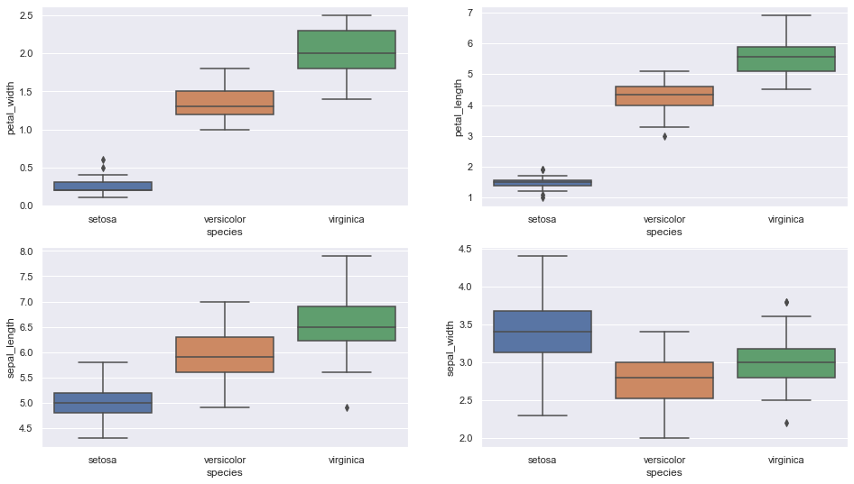
Boxplot for All Attributes of IRIS dataset

Slide 60
Insights from Boxplots of IRIS Dataset
Setosa is having smaller feature and less distributed
Versicolor is distributed in a average manner and average features
Virginica is highly distributed with large no .of values and features
Clearly the mean/ median values are being shown by each plots for various features(sepal length & width, petal length & width)

Slide 61
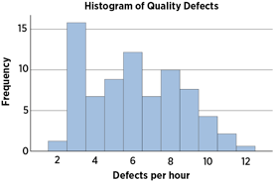
What is a histogram?
A frequency distribution shows how often each different value in a set of data occurs.
It looks very much like a bar chart, but there are important differences between them.

Slide 62
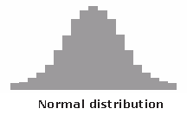
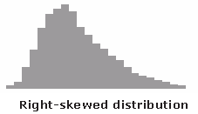
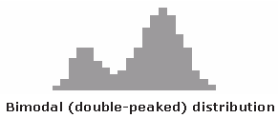
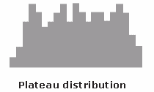
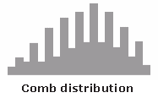
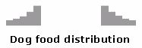
Typical Histogram Shapes
Credit: https://asq.org/quality-resources/histogram

Slide 63
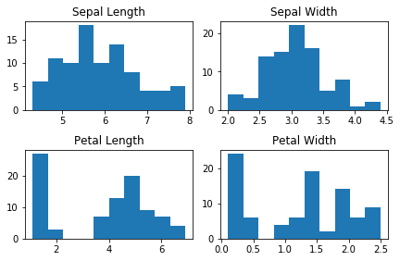
Histogram
When Data

Slide 64
Histogram
When data is Numerical

Slide 65
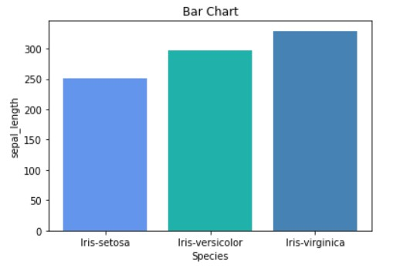
Barplot
When data is Categorical

Slide 66
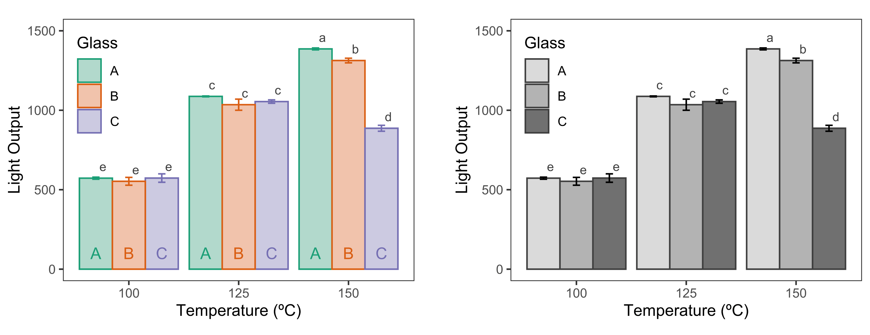
Barplot: Example 2

Slide 67
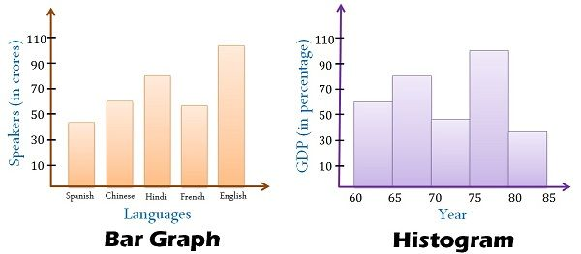
Differences in Barplot and Histogram
You can’t reorder bars in a histogram; you can in a bar chart
Convention: Bars touch in histogram, not in barplot

Slide 68
Differences Summary
BASIS FOR COMPARISON | HISTOGRAM | BAR GRAPH
Meaning | Histogram refers to a graphical representation, that displays data by way of bars to show the frequency of numerical data. | Bar graph is a pictorial representation of data that uses bars to compare different categories of data.
Indicates | Distribution of non-discrete variables | Comparison of discrete variables
Presents | Quantitative data | Categorical data
Spaces | Bars touch each other, hence there are no spaces between bars | Bars do not touch each other, hence there are spaces between bars.
Elements | Elements are grouped together, so that they are considered as ranges. | Elements are taken as individual entities.
Can bars be reordered? | No | Yes
Width of bars | Need not to be same | Same
Credit: https://keydifferences.com/difference-between-histogram-and-bar-graph.html

Slide 69
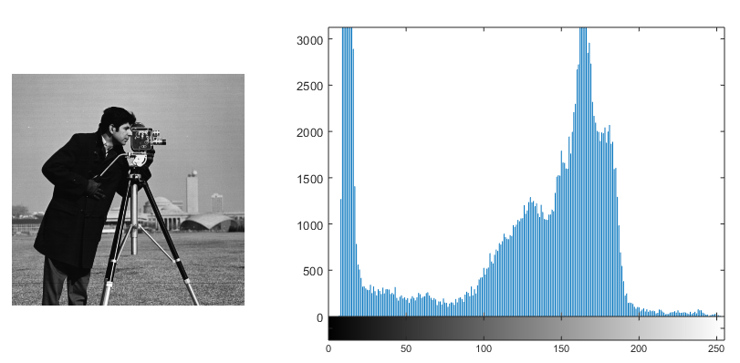
Histogram for Images
What does the histogram for an image represent?

Slide 70
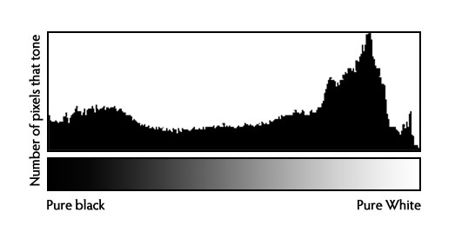
Histogram for Images
What does the histogram for an image represent?

Slide 71
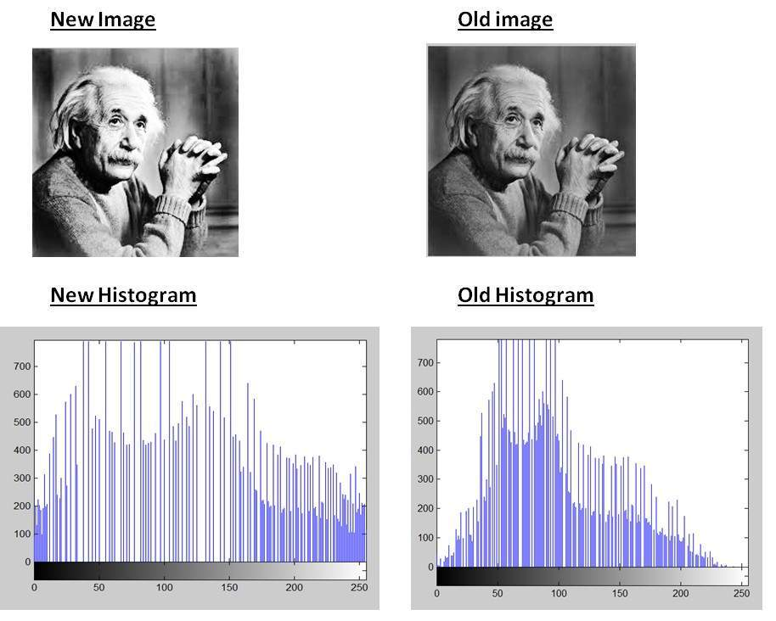
Histogram: Important for Photographers

Slide 72

How we Precieve color
Notes:
You think you see million of colors but you basically just see three colors Red Green and Blue

Slide 73
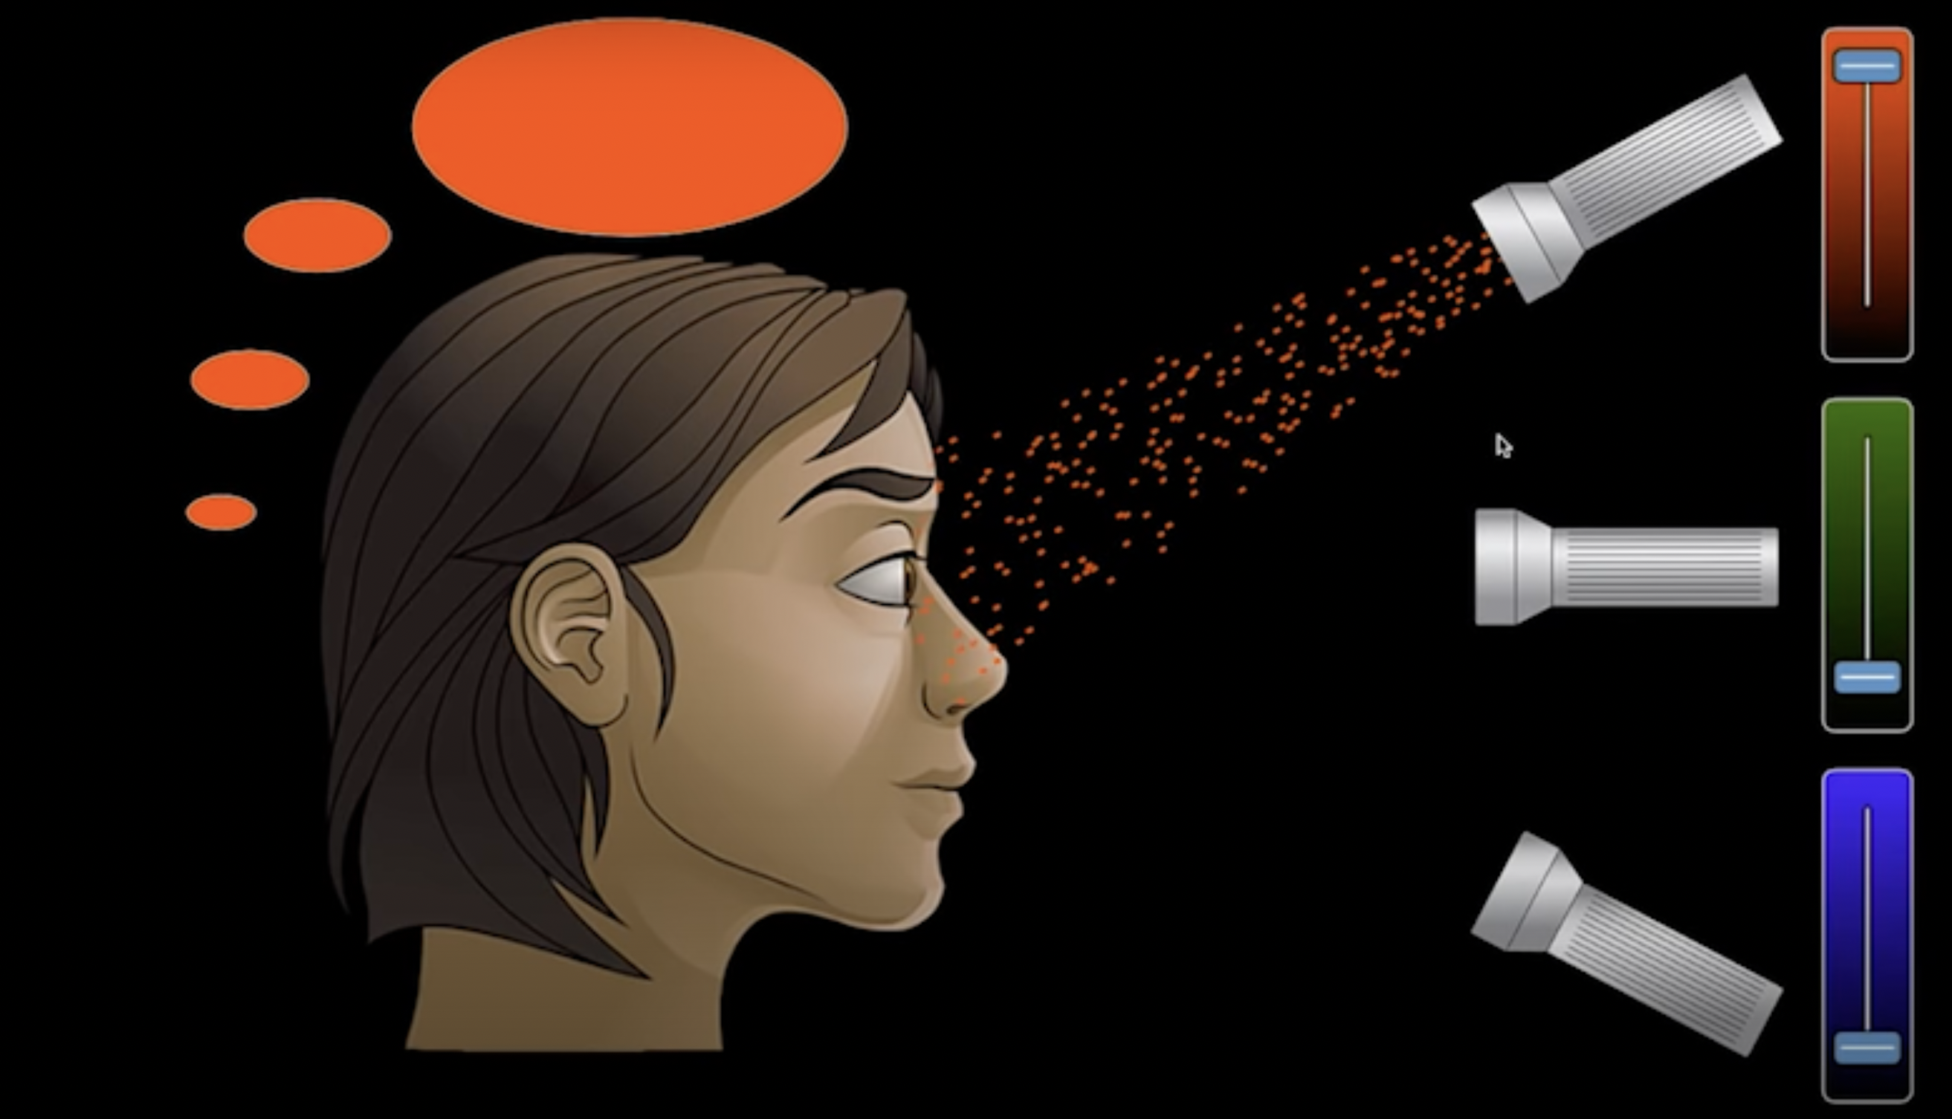
Just Red Pixel

Slide 74
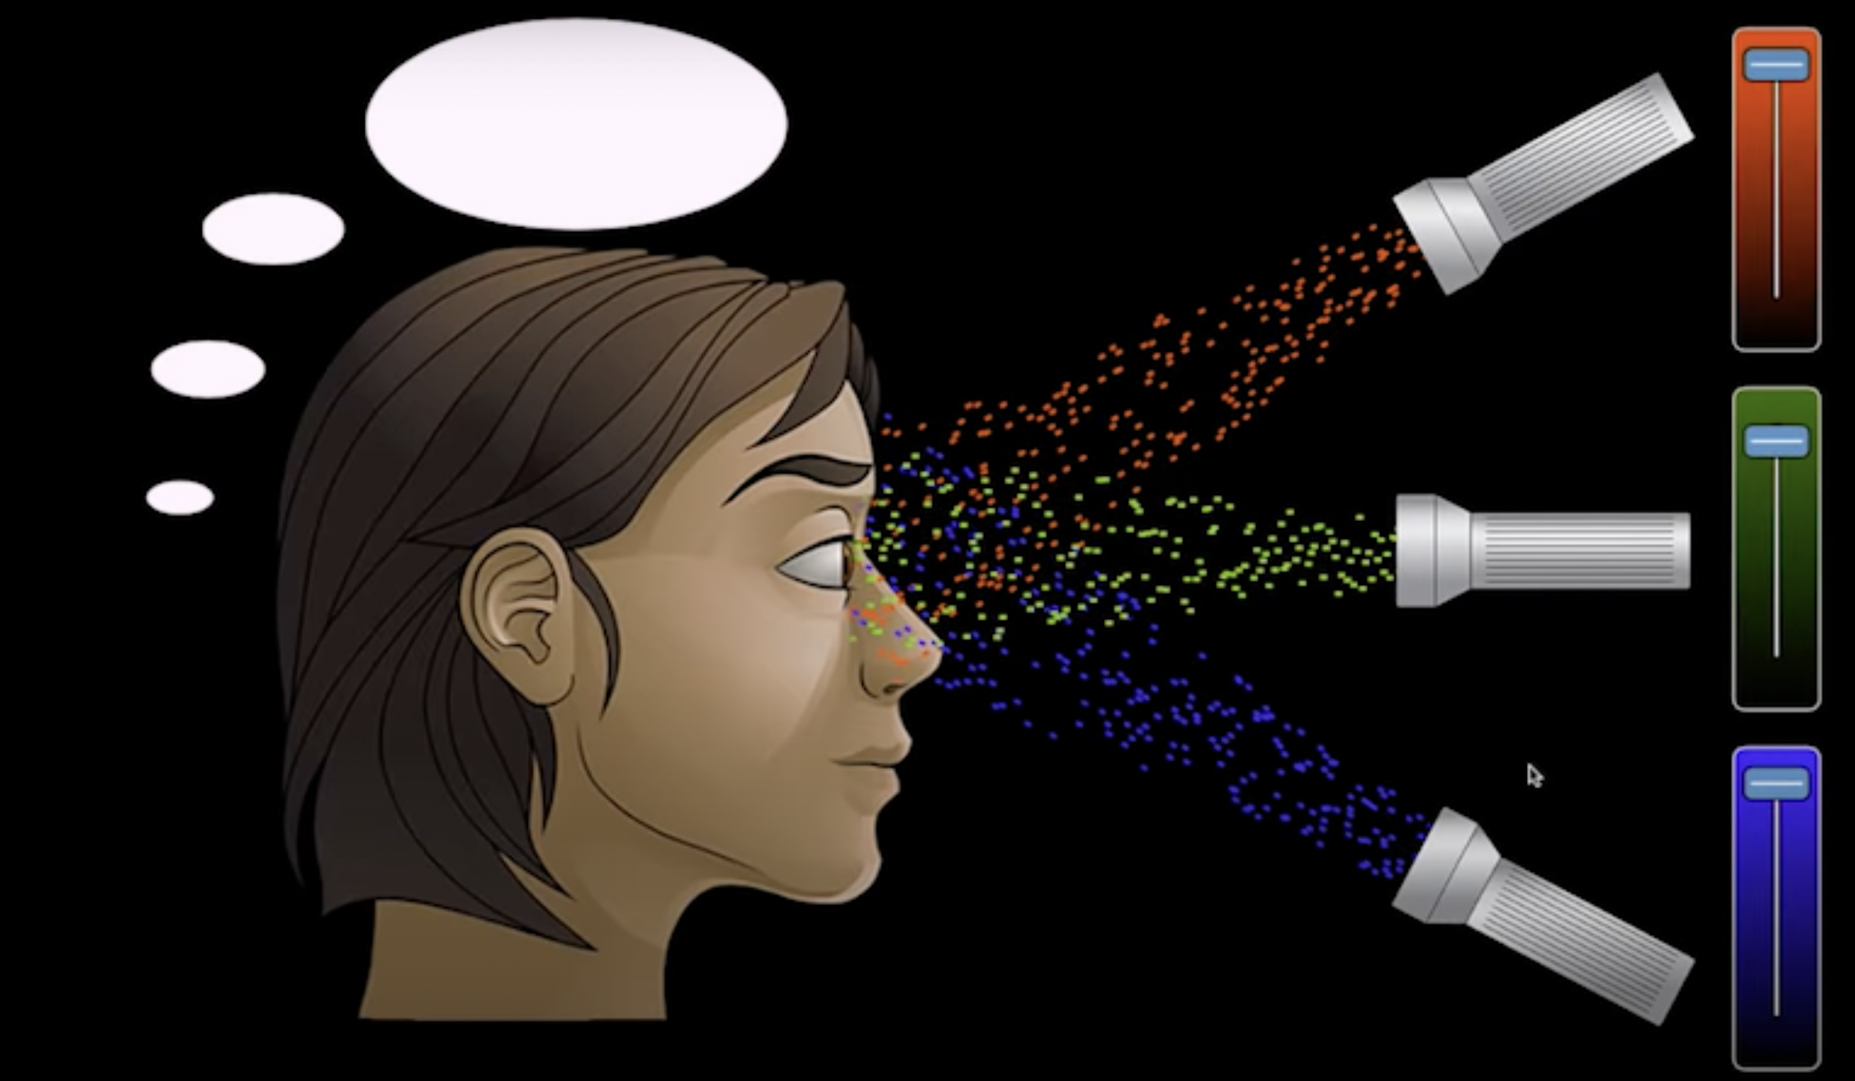
All Pixels with full intensity – You precieve White

Slide 75
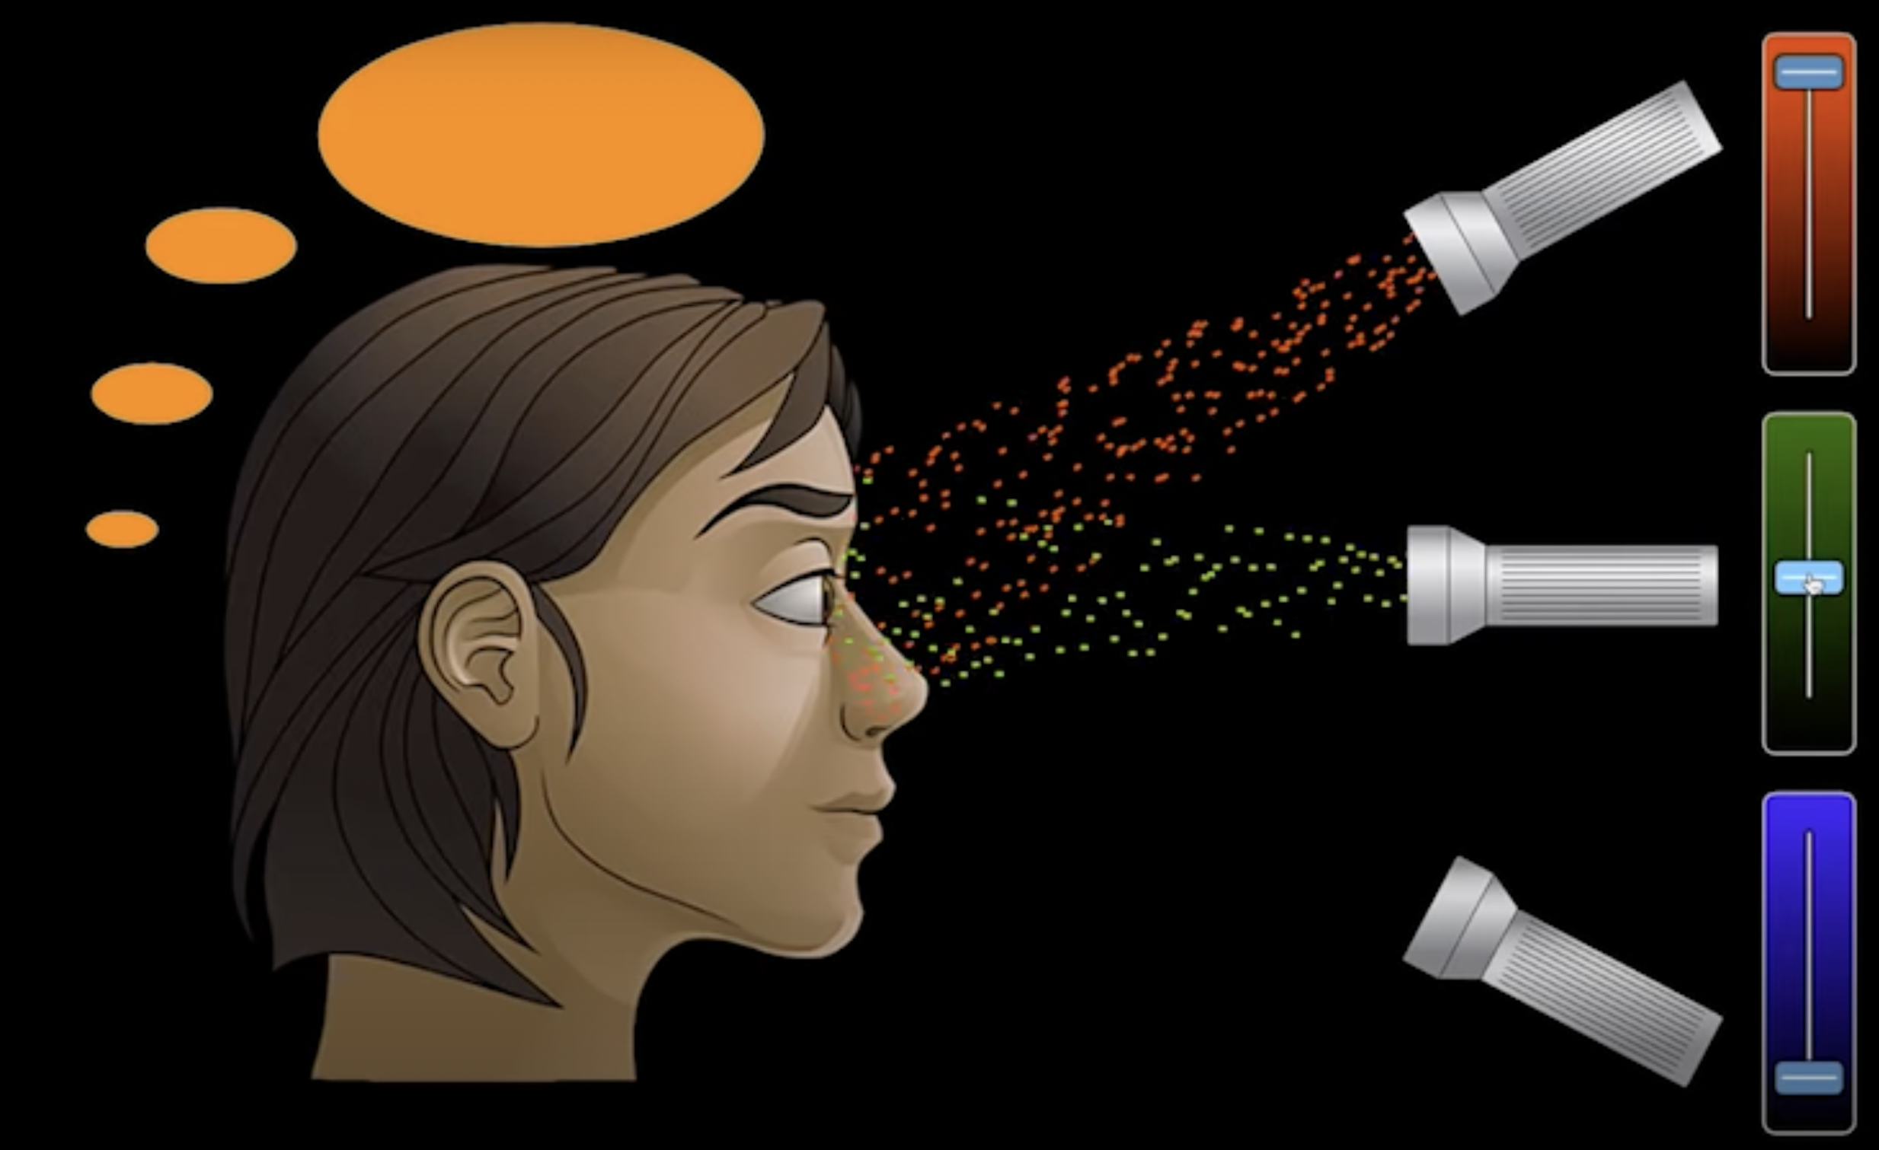
How you see Orange

Slide 76
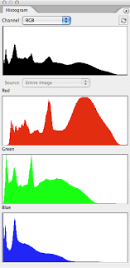
Histogram for Color Images

Slide 77

Multidimensional Line Chart

Slide 78

Variables with completely different scale
Notes:
If we are focusing on Low Price and City and Hwy Milage may be CAR C should be our choice but we have to compromise on Passenger room and engine displacement

Slide 79

Scatter plot
Provides a first look at bivariate data to see clusters of points, outliers, etc
Each pair of values is treated as a pair of coordinates and plotted as points in the plane

Slide 80
Positively and Negatively Correlated Data
The left half fragment is positively correlated
The right half is negative correlated

Slide 81



Uncorrelated Data

Slide 82

Scatter Plot

Slide 83

Scatter Plot Matrix
red = Satosa blue = Versicolor green = Virginica

Slide 84
Scatter Plot and Parallel Coordinates Insights
High correlation between petal length and petal width columns.
Setosa has both low petal length and width
Versicolor has both average petal length and width
Virginica has both high petal length and width.
Sepal width for setosa is high and length is low.
Versicolor have average values for sepal dimensions.
Virginica has small width but large sepal length
What is correlation?

Slide 85

Scatterplot Matrices
Used by ermission of M. Ward, Worcester Polytechnic Institute
Matrix of scatterplots (x-y-diagrams) of the k-dim. data [total of (k2/2-k) scatterplots]

Slide 86

Percentiles
Percentile is a value on a scale of 100 that indicates the percent of a distribution that is equal to or below it.
Percentile is differnet that percentage
40 percentile means 40 % of the students are below this student.(competative data)

Slide 87

Quantiles
Quantile is a measure that tells how many values in a data set are above or below a certain limit, It divides the members of the dataset into equally-sized subgroups.

Slide 88
Quantile Plot
Effective for univariate data distribution
Univariate data has only one variable (i.e., feature or column or dimension or attribute)
Multivariate data has two or more variables
What is univariate data analysis?

Slide 89



Quantile Plot
Displays all of the data for the given attribute
Plots Quantile Information.
Suppose you have $N$ data points.
The data points are sorted in increasing order
Let $x_{i}$, for $i=1$ to $N$, be the data sorted in increasing order so that $x_{1}$ is the smallest observation and $x_{N}$ is the largest for some ordinal or numeric attribute $X$.
Each observation $x_{i}$ is paired with a percentage $f_{i}$ which indicates that approximately $f_{i}×100\%$ of the data are below the value $x_{i}$.
$$f_{i}=\frac{i −0.5}{N}$$
Notes:
f1 = (1-0.5)/10 = 0.05 f2 = 0.15. ….. f10 = 9.95

Slide 90


Quantile Plot: Example
$$f_{i}=\frac{i −0.5}{N}$$

Slide 91

q-q Plot
25% of items sold at branch 1 were less than or equal to $60, while 25% of items sold at branch 2 were less than or equal to $64.
Unit Prices sold at two branches
Each point shows the unit price of items sold at branch 1 versus branch 2 for each quantile
The darker points correspond to the data for Q1, the median, and Q3 respectively
We will take equal number of data points for each branch (i.e., length of x and y axis is the same)

Slide 92
q-q Plot
At median, 50% of items sold at branch 1 were less than $78 while 50% of items at branch 2 were less than $85
Unit Prices sold at two branches
Each point shows the unit price of items sold at branch 1 versus branch 2 for each quantile
The darker points correspond to the data for Q1, the median, and Q3 respectively
We will take equal number of data points for each branch (i.e., length of x and y axis is the same)

Slide 93
q-q Plot
Unit Prices sold at two branches
Each point shows the unit price of items sold at branch 1 versus branch 2 for each quantile
The darker points correspond to the data for Q1, the median, and Q3 respectively
Overall, items sold at branch 1 tend to be lower in price than those at branch 2
We will take equal number of data points for each branch (i.e., length of x and y axis is the same)

Slide 94
GETTING TO KNOW YOUR DATA Data Visualization

Slide 95
Data Visualization
Why data visualization?
Gain insight into an information space by mapping data onto graphical primitives
Provide qualitative overview of large data sets
Search for patterns, trends, structure, irregularities, relationships among data
Help find interesting regions and suitable parameters for further quantitative analysis
Provide a visual proof of computer representations derived
Categorization of visualization methods:
Pixel-oriented visualization techniques
Geometric projection visualization techniques
Icon-based visualization techniques
Hierarchical visualization techniques
Visualizing complex data and relations

Slide 96
Pixel-Oriented Visualization Techniques
For a data set of m dimensions, create m windows on the screen, one for each dimension
The m dimension values of a record are mapped to m pixels at the corresponding positions in the windows
The colors of the pixels reflect the corresponding values
Income
(b) Credit Limit
(c) transaction volume
(d) age
96
Notes:
96

Slide 97
Geometric Projection Visualization
Disvantage of Pixel Oriented Visualization is that they cannot help much in undertsnading the distribution of data in a multidimensional space
A scatter plot displas 2-D data point using cartesian coordinates. A third dimension can be added by using differnet colors of shapes to represnet different data points

Slide 98

Geometric Projection Visualization

Slide 99
Icon-Based Visualization Techniques
Visualization of the data values as features of icons
Typical visualization methods
Chernoff Faces
Stick Figures
General techniques
Shape coding: Use shape to represent certain information encoding
Color icons: Use color icons to encode more information
Tile bars: Use small icons to represent the relevant feature vectors in document retrieval

Slide 100

Chernoff Faces
A way to display variables on a two-dimensional surface, e.g., let x be eyebrow slant, y be eye size, z be nose length, etc.
The figure shows faces produced using 10 characteristics--head eccentricity, eye size, eye spacing, eye eccentricity, pupil size, eyebrow slant, nose size, mouth shape, mouth size, and mouth opening): Each assigned one of 10 possible values, generated using Mathematica (S. Dickson)
REFERENCE: Gonick, L. and Smith, W. The Cartoon Guide to Statistics. New York: Harper Perennial, p. 212, 1993
Weisstein, Eric W. "Chernoff Face." From MathWorld--A Wolfram Web Resource. mathworld.wolfram.com/ChernoffFace.html

Slide 101

Stick Figure
A census data figure showing age, income, gender, education, etc.
used by permission of G. Grinstein, University of Massachusettes at Lowell
A 5-piece stick figure (1 body and 4 limbs w. different angle/length)
Two attributes mapped to axes, remaining attributes mapped to angle or length of limbs”. Look at texture pattern

Slide 102
Hierarchical Visualization Techniques
Visualization of the data using a hierarchical partitioning into subspaces
Methods
Dimensional Stacking
Worlds-within-Worlds
Tree-Map
Cone Trees
InfoCube

Slide 103
Dimensional Stacking
Partitioning of the n-dimensional attribute space in 2-D subspaces, which are ‘stacked’ into each other
Partitioning of the attribute value ranges into classes. The important attributes should be used on the outer levels.
Adequate for data with ordinal attributes of low cardinality
But, difficult to display more than nine dimensions
Important to map dimensions appropriately

Slide 104

Dimensional Stacking
Used by permission of M. Ward, Worcester Polytechnic Institute
Visualization of oil mining data with longitude and latitude mapped to the outer x-, y-axes and ore grade and depth mapped to the inner x-, y-axes

Slide 105
GETTING TO KNOW YOUR DATA $χ^{2}$ (Chi-Square) test

Slide 106
$χ^{2}$Correlation for Nominal Data
Suppose that a group of 1500 people was surveyed.
The gender of each person was noted. Each person was polled as to whether his or her preferred type of reading material was ﬁction or nonﬁction.
Thus, we have two attributes, gender and preferred reading.
The observed frequency (or count) of each possible joint event is summarized in the contingency table

Slide 107
$χ^{2}$Correlation for Nominal Data
 | male | female | Total
fiction
non-fiction
Total

Slide 108
$χ^{2}$Correlation for Nominal Data
 | male | female | Total
fiction | 250 | 200 | 450
non-fiction | 50 | 1000 | 1050
Total | 300 | 1200 | 1500
1- Find expected values for this contingency Table
$$e_{11}=\frac{count\left(male\right)×count\left(fiction\right)}{n}$$
$$e_{11}=\frac{300×450}{1500}=90$$
 | male | female
fiction | 90
non-fiction

Slide 109
$χ^{2}$Correlation for Nominal Data
 | male | female | Total
fiction | 250 | 200 | 450
non-fiction | 50 | 1000 | 1050
Total | 300 | 1200 | 1500
1- Find expected values for this contingency Table
$$e_{12}=\frac{count\left(female\right)×count\left(fiction\right)}{n}$$
$$e_{12}=\frac{1200×450}{1500}=360$$
 | male | female
fiction | 90 | 360
non-fiction

Slide 110

$χ^{2}$Correlation for Nominal Data
 | male | female | Total
fiction | 250 | 200 | 450
non-fiction | 50 | 1000 | 1050
Total | 300 | 1200 | 1500
1- Find expected values for this contingency Table
$$e_{12}=\frac{count\left(female\right)×count\left(fiction\right)}{n}$$
$$e_{12}=\frac{1200×450}{1500}=360$$
 | male | female
fiction | 90 | 360
non-fiction | 210 | 840

Slide 111
$χ^{2}$Correlation for Nominal Data
 | male | female | Total
fiction | 250 | 200 | 450
non-fiction | 50 | 1000 | 1050
Total | 300 | 1200 | 1500
 | male | female
fiction | 90 | 360
non-fiction | 210 | 840
2- Compute $χ^{2}$
$$χ^{2}=\frac{{\left(250−90\right)}^{2}}{90}+\frac{{\left(50−210\right)}^{2}}{210}+\frac{{\left(200−360\right)}^{2}}{360}+\frac{{\left(1000−840\right)}^{2}}{840}$$
$$χ^{2}=284.44+121.90+71.11+30.48=507.93$$

Slide 112
$χ^{2}$Correlation for Nominal Data
 | male | female | Total
fiction | 250 (90) | 200 (360) | 450
non-fiction | 50 (210) | 1000 (840) | 1050
Total | 300 | 1200 | 1500
2- Compute $χ^{2}$
$$χ^{2}=\frac{{\left(250−90\right)}^{2}}{90}+\frac{{\left(50−210\right)}^{2}}{210}+\frac{{\left(200−360\right)}^{2}}{360}+\frac{{\left(1000−840\right)}^{2}}{840}$$
$$χ^{2}=284.44+121.90+71.11+30.48=507.93$$

Slide 113
$χ^{2}$Analysis
The larger the $χ^{2}$ value, the more likely the variables are related
The cells that contribute the most to the $χ^{2}$ value are those whose actual count is very different from the expected count
Remember: Correlation does not imply causality
Null Hypothesis: There is no relation between “gender” and “preferred reading ”
Alternate Hypothesis: There is significant relation between “gender” and “preferred reading ”
$$χ^{2}=507.93$$
$$Significance Level \left(∝\right)=0.05 (5\%)$$
$$Degree of Freedom=\left(columns−1\right)×\left(rows−1\right)=(2−1)×(2−1)=1$$

Slide 114

$χ^{2}$Analysis
$$Significance Level \left(∝\right)=0.05 (5\%)$$
$$χ^{2}=507.93$$
$$Degree of Freedom=1$$
$$χ_{calculated}^{2}>χ_{tabular}^{2}$$
$∴$we reject Null hypothesis and accept alternate hypothesis

Slide 115
$χ^{2}$Analysis
Since our computed value is above the tabular value, we can reject the hypothesis that “gender” and “preferred reading ” are independent and conclude that the two attributes are (strongly) correlated for the given group of people.
Significance level can be changed but normally it is 5%

Slide 116
Chi-Square ${(χ}^{2})$: Example 2
Qualification/Marital Status | Middle School | High School | BS | MS | PhD | Total
Never Married | 18 | 36 | 21 | 9 | 6 | 90
Married | 12 | 36 | 45 | 36 | 21 | 150
Divorced | 6 | 9 | 9 | 3 | 3 | 30
Widowed | 3 | 9 | 9 | 6 | 3 | 30
Total | 39 | 90 | 84 | 54 | 33 | 300
Observed Values
Null Hypothesis: There is no relation between “marital status” and “qualification”
Alternate Hypothesis: There is significant relation between “marital status” and “qualification”
$$Significance Level \left(∝\right)=0.05 (5\%)$$
Credit: Vectors Academy

Slide 117
Chi-Square ${(χ}^{2})$: Example 2
$$e_{11}=\frac{row_{total}×column_{total}}{n}$$
Qualification/Marital Status | Middle School | High School | BS | MS | PhD | Total
Never Married | 18 | 36 | 21 | 9 | 6 | 90
Married | 12 | 36 | 45 | 36 | 21 | 150
Divorced | 6 | 9 | 9 | 3 | 3 | 30
Widowed | 3 | 9 | 9 | 6 | 3 | 30
Total | 39 | 90 | 84 | 54 | 33 | 300
Observed Values
Qualification/Marital Status | Middle School | High School | BS | MS | PhD
Never Married | $$\frac{90×39}{300}=11.7$$ | $$\frac{90×90}{300}=27$$ | $$\frac{90×84}{300}=25.2$$ | $$\frac{90×54}{300}=16.2$$ | $$\frac{90×33}{300}=9.9$$
Married
Divorced
Widowed
Expected Values
Credit: Vectors Academy

Slide 118
Chi-Square ${(χ}^{2})$: Example 2
$$e_{11}=\frac{row_{total}×column_{total}}{n}$$
Qualification/Marital Status | Middle School | High School | BS | MS | PhD | Total
Never Married | 18 | 36 | 21 | 9 | 6 | 90
Married | 12 | 36 | 45 | 36 | 21 | 150
Divorced | 6 | 9 | 9 | 3 | 3 | 30
Widowed | 3 | 9 | 9 | 6 | 3 | 30
Total | 39 | 90 | 84 | 54 | 33 | 300
Observed Values
Qualification/Marital Status | Middle School | High School | BS | MS | PhD
Never Married | $$\frac{90×39}{300}=11.7$$ | $$\frac{90×90}{300}=27$$ | $$\frac{90×84}{300}=25.2$$ | $$\frac{90×54}{300}=16.2$$ | $$\frac{90×33}{300}=9.9$$
Married | 19.5 | 45 | 42 | 27 | 16.5
Divorced | 3.9 | 9 | 8.4 | 5.4 | 3.3
Widowed | 3.9 | 9 | 8.4 | 5.4 | 3.3
Expected Values
Credit: Vectors Academy

Slide 119
Chi-Square ${(χ}^{2})$: Example 2
$$e_{11}=\frac{row_{total}×column_{total}}{n}$$
Qualification/Marital Status | Middle School | High School | BS | MS | PhD | Total
Never Married | 18 (11.7) | 36 (27) | 21 (25.2) | 9 (16.2) | 6 (9.9) | 90
Married | 12 (19.5) | 36 (45) | 45 (42) | 36 (27) | 21 (16.5) | 150
Divorced | 6 (3.9) | 9 (9) | 9 (8.4) | 3 (5.4) | 3 (3.3) | 30
Widowed | 3 (3.9) | 9 (9) | 9 (8.4) | 6 (5.4) | 3 (3.3) | 30
Total | 39 | 90 | 84 | 54 | 33 | 300
Observed Values
(Expected Values)
$$χ^{2}=23.57$$
$$Degree of Freedom=\left(columns−1\right)×(rows−1)$$
$$Degree of Freedom=\left(5−1\right)×\left(4−1\right)=4×3=12$$
Credit: Vectors Academy

Slide 120
Chi-Square ${(χ}^{2})$: Example 2
$$χ^{2}=23.57$$
$$Degree of Freedom=12$$
$$Significance Level \left(∝\right)=0.05 (5\%)$$
$$χ_{calculated}^{2}>χ_{tabular}^{2}$$
$∴$we reject Null hypothesis and accept alternate hypothesis
Credit: Vectors Academy

Slide 121
Measuring Data Similarity and Dissimilarity

Slide 122
Similarity and Dissimilarity
Similarity
Numerical measure of how alike two data objects are
Value is higher when objects are more alike
Often falls in the range [0,1]
Dissimilarity (e.g., distance)
Numerical measure of how different two data objects are
Lower when objects are more alike
Minimum dissimilarity is often 0
Upper limit varies
Proximity refers to a similarity or dissimilarity

Slide 123
Data Matrix and Dissimilarity Matrix
Data matrix
n data points with p dimensions
Two modes
Dissimilarity matrix
n data points, but registers only the distance
A triangular matrix
Single mode

Slide 124
Similarity and Dissimilarity of Instances/Records
In data mining applications, such as clustering, outlier analysis, and nearest-neighbor classification:
We need ways to assess how alike or unlike objects are in comparison to one another
A store may want to search for clusters of customer objects with similar characteristics
Groups of characteristics like similar income, similar area of residence, and similar age for marketing purposes
A cluster is a collection of data objects such that:
Objects within a cluster are similar to one another but dissimilar to the objects in other clusters

Slide 125



Dissimilarity Matrix
$object×object$ structure that stores proximities that are available for all pairs of $n$ objects
Where:
$d(i,j)$ is the measured dissimilarity or “difference” between objects $i$ and $j$
If we know distance between two objects, we know similarity too!
But How to Compute Similarity or Dissimilarity of objects?

Slide 126


Proximity Measures Between Nominal Attributes
Recall: Nominal attributes can take on two or more states
Color: red, yellow, green ,pink, …, $color_{m}$
How is dissimilarity computed between objects described by nominal attributes?
Where:
$p$ are the total number of nominal attributes describing the objects
$m$ are the number of attributes for which $object i$ and $object j$ are in same state (have same values)
$$d\left(i,j\right)=\frac{p−m}{p}$$

Slide 127





Proximity Measures Between Nominal Attributes: Example
Where:
$p$ are the total number of nominal attributes describing the objects
$m$ are the number of attributes for which $object i$ and $object j$ are in same state (have same values)
$$d\left(i,j\right)=\frac{p−m}{p}$$
$$sim\left(i,j\right)=1−d\left(i,j\right)=\frac{m}{p}$$
Dissimilarity Matrix

Slide 128
Proximity Measures for Binary Attributes
Recall: Symmetric Binary Attributes = States equally valuable
Recall: Asymmetric Binary Attributes = State not equally valuable
But values for both kinds of Binary Attributes are either 0 or 1

Slide 129






Proximity Measures for Binary Attributes
Step 1: Draw a Contingency Table
Symmetric Dissimilarity
Asymmetric Dissimilarity
Asymmetric
Symmetric
$$d\left(i,j\right)=\frac{r+s}{q+r+s+t}$$
$$d\left(i,j\right)=\frac{r+s}{q+r+s}$$
$$d\left(Jack, Jim\right)=\frac{r+s}{q+r+s}$$
$$d\left(Jack, Jim\right)=\frac{1+1}{1+1+1}=0.67$$

Slide 130



Proximity Measures for Binary Attributes
$$d\left(i,j\right)=\frac{r+s}{q+r+s}$$
$$d\left(Jack, Mary\right)=\frac{0+1}{2+0+1}=0.33$$
$$d\left(Jim, Mary\right)=\frac{1+2}{1+1+2}=0.75$$

Slide 131
Standardizing Numeric Data
Z-score:
X: raw score to be standardized, μ: mean of the population, σ: standard deviation
the distance between the raw score and the population mean in units of the standard deviation
negative when the raw score is below the mean, “+” when above
An alternative way: Calculate the mean absolute deviation
where
standardized measure (z-score):
Using mean absolute deviation is more robust than using standard deviation

Slide 132
Example: Data Matrix and Dissimilarity Matrix
Data Matrix
Dissimilarity Matrix
(with Euclidean Distance)

Slide 133
Distance on Numeric Data: Minkowski Distance
Minkowski distance: A popular distance measure
where i = (x_{i1}, x_{i2}, …, x_{ip}) and j = (x_{j1}, x_{j2}, …, x_{jp}) are two p-dimensional data objects, and h is the order (the distance so defined is also called L-h norm)
Properties
d(i, j) > 0 if i ≠ j, and d(i, i) = 0 (Positive definiteness)
d(i, j) = d(j, i) (Symmetry)
d(i, j) ≤ d(i, k) + d(k, j) (Triangle Inequality)
A distance that satisfies these properties is a metric

Slide 134
Special Cases of Minkowski Distance
h = 1: Manhattan (city block, L₁ norm) distance
E.g., the Hamming distance: the number of bits that are different between two binary vectors
h = 2: (L₂ norm) Euclidean distance
h → ∞. “supremum” (L_{max} norm, L∞ norm) distance.
This is the maximum difference between any component (attribute) of the vectors

Slide 135
Example: Minkowski Distance
Dissimilarity Matrices
Manhattan (L₁)
Euclidean (L₂)
Supremum

Slide 136
Ordinal Variables
An ordinal variable can be discrete or continuous
Order is important, e.g., rank
Can be treated like interval-scaled
replace x_{if} by their rank
map the range of each variable onto [0, 1] by replacing i-th object in the f-th variable by
compute the dissimilarity using methods for interval-scaled variables

Slide 137
Attributes of Mixed Type
A database may contain all attribute types
Nominal, symmetric binary, asymmetric binary, numeric, ordinal
One may use a weighted formula to combine their effects
f is binary or nominal:
d_{ij}^{(f)} = 0 if x_{if} = x_{jf} , or d_{ij}^{(f)} = 1 otherwise
f is numeric: use the normalized distance
f is ordinal
Compute ranks r_{if} and
Treat z_{if} as interval-scaled

Slide 138

Cosine Similarity
A document can be represented by thousands of attributes, each recording the frequency of a particular word (such as keywords) or phrase in the document.
Other vector objects: gene features in micro-arrays, …
Applications: information retrieval, biologic taxonomy, gene feature mapping, ...
Cosine measure: If d₁ and d₂ are two vectors (e.g., term-frequency vectors), then
cos(d₁, d₂) = (d₁ • d₂) /||d₁|| ||d₂|| ,
where • indicates vector dot product, ||d||: the length of vector d

Slide 139
Example: Cosine Similarity
cos(d₁, d₂) = (d₁ • d₂) /||d₁|| ||d₂|| ,
where • indicates vector dot product, ||d|: the length of vector d
Ex: Find the similarity between documents 1 and 2.
d₁ = (5, 0, 3, 0, 2, 0, 0, 2, 0, 0)
d₂ = (3, 0, 2, 0, 1, 1, 0, 1, 0, 1)
d₁•d₂ = 5*3+0*0+3*2+0*0+2*1+0*1+0*1+2*1+0*0+0*1 = 25
||d₁||= (5*5+0*0+3*3+0*0+2*2+0*0+0*0+2*2+0*0+0*0)^{0.5}=(42)^{0.5} = 6.481
||d₂||= (3*3+0*0+2*2+0*0+1*1+1*1+0*0+1*1+0*0+1*1)^{0.5}=(17)^{0.5} = 4.12
cos(d₁, d₂ ) = 0.94

Slide 140
Summary
Data attribute types: nominal, binary, ordinal, interval-scaled, ratio-scaled
Many types of data sets, e.g., numerical, text, graph, Web, image.
Gain insight into the data by:
Basic statistical data description: central tendency, dispersion, graphical displays
Data visualization: map data onto graphical primitives
Measure data similarity
Above steps are the beginning of data preprocessing.
Many methods have been developed but still an active area of research.

Slide 141
Reading …
Chap 2 Han and Kamber

